Slide 1
Matplotlib: Scientific plots with Python

Slide 2
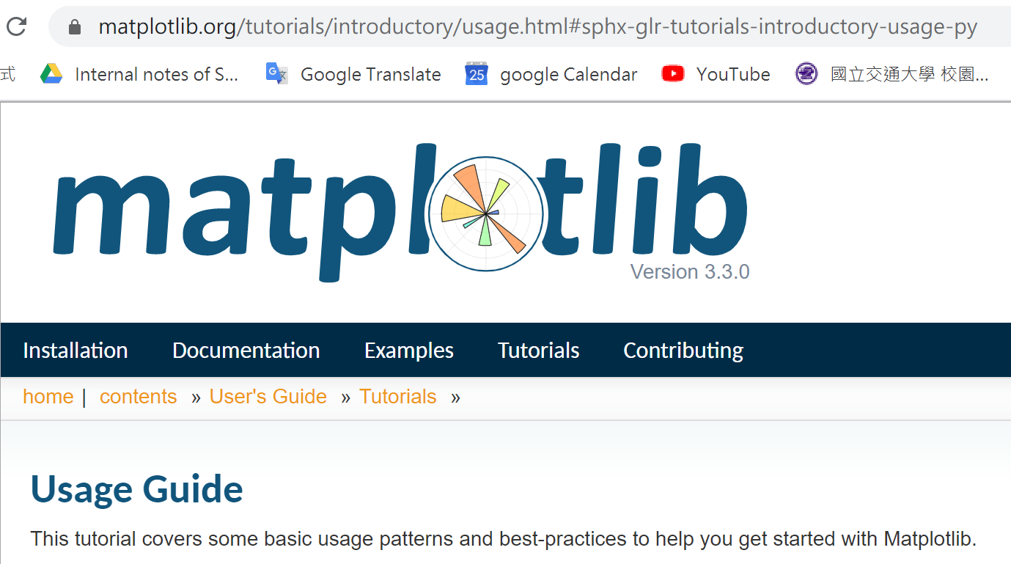
Matplotlib
Matplotlib is a Python 2D plotting library which produces publication quality figures in a variety of hardcopy formats and interactive environments across platforms. See https://matplotlib.org/
The usage guide:
https://matplotlib.org/tutorials/introductory/usage.html#sphx-glr-tutorials-introductory-usage-py

Slide 3
Matplotlib: tutorial resources
On-line tutorial:
https://www.datacamp.com/community/tutorials/matplotlib-tutorial-python#anatomy
https://pythonprogramming.net/matplotlib-intro-tutorial/
https://mofanpy.com/tutorials/data-manipulation/plt/

Slide 4
Matplotlib: tutorial resources
https://en.wikipedia.org/wiki/John_D._Hunter
Matplotlib is a plotting library for the Python programming language and its numerical mathematics extension NumPy.
Matplotlib was originally written by John D. Hunter.
Matplotlib was originally conceived to visualize electrocorticography (ECoG) data (腦皮層圖) of epilepsy patients (癲癇患者) during post-doctoral research in neurobiology.^{[4]} The open-source tool emerged as the most widely used plotting library for the Python programming language, and a core component of the scientific Python stack, along with Numpy, Scipy and IPython.^{[6]}
Matplotlib was used for data visualization during landing of the Phoenix spacecraft (鳳凰號火星探測器) in 2008 as well as for the creation of the first image of a black hole.

Slide 5
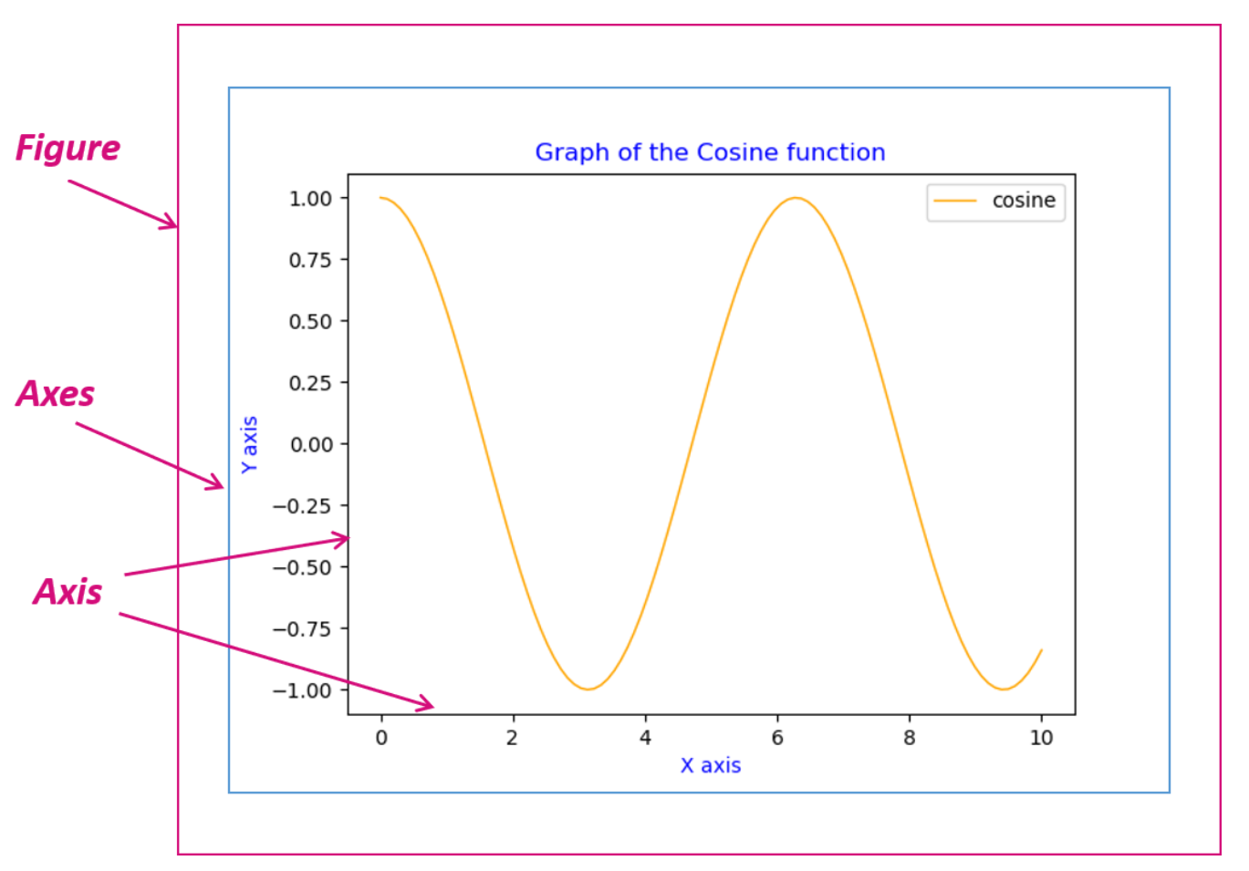
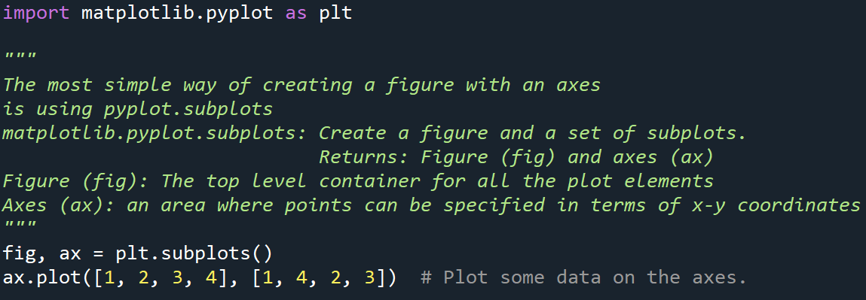
create a figure
Matplotlib graphs your data on Figures (i.e., windows, Jupyter widgets, etc.), each of which can contain one or more Axes (i.e., an area where points can be specified in terms of x-y coordinates
matplotlib.pyplot.subplots:
Create a figure and a set of subplots.
Returns: figure (fig), axes (ax)
C:\Users\sjche\Desktop\Work place\teaching\computational physics\Python\Matplotlib\2D plot_simple.py

Slide 6
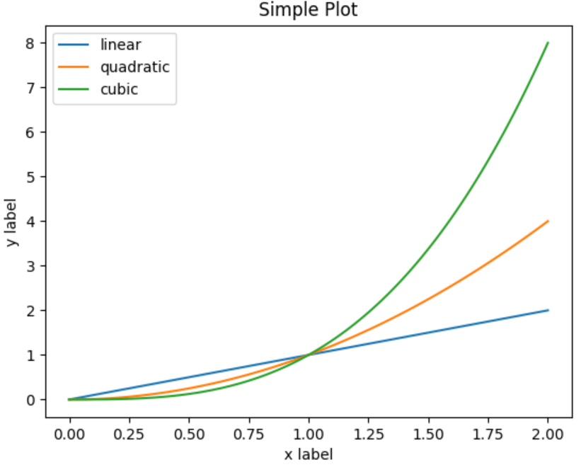
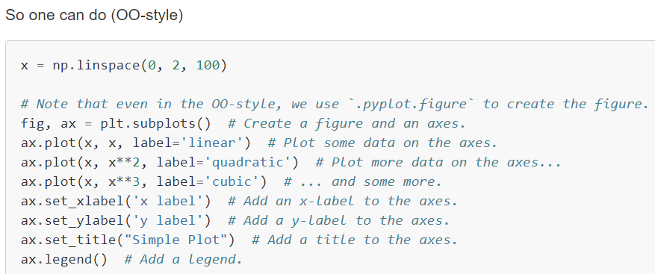
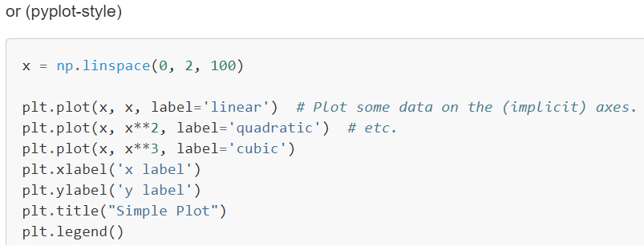
The object-oriented interface and the pyplot interface
There are essentially two ways to use Matplotlib:
Use the "object-oriented (OO) style".
use pyplot functions for plotting.
https://matplotlib.org/stable/tutorials/introductory/usage.html#sphx-glr-tutorials-introductory-usage-py
Matplotlib's documentation and examples use both the OO and the pyplot approaches (which are equally powerful), and you should feel free to use either (however, it is preferable pick one of them and stick to it, instead of mixing them). In general, we suggest to restrict pyplot to interactive plotting (e.g., in a Jupyter notebook), and to prefer the OO-style for non-interactive plotting (in functions and scripts that are intended to be reused as part of a larger project).

Slide 7
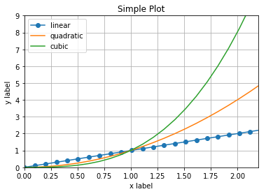
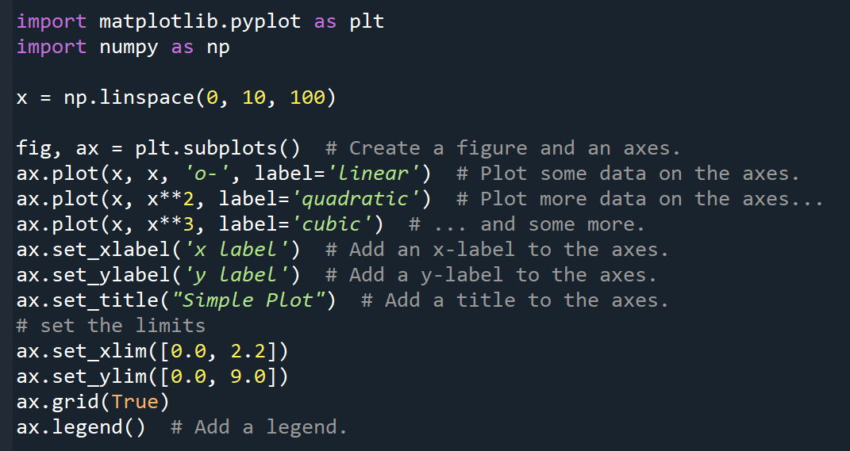
Axes
https://matplotlib.org/api/axes_api.html
C:\Users\sjche\Desktop\Work place\teaching\computational physics\Python\Matplotlib\2D plot_axes.py

Slide 8
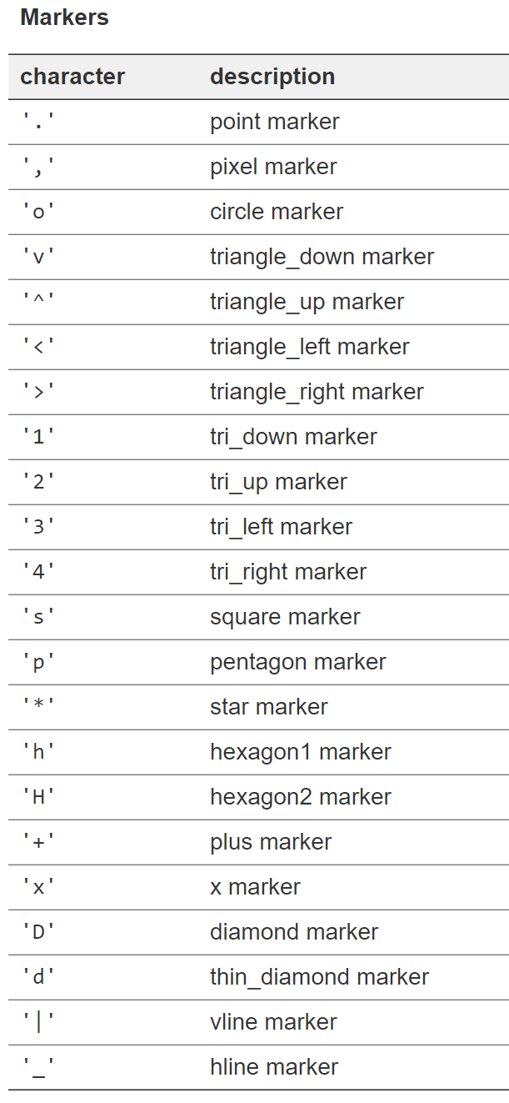
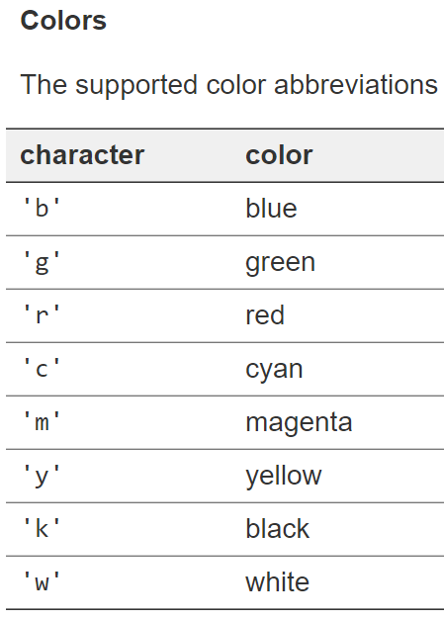
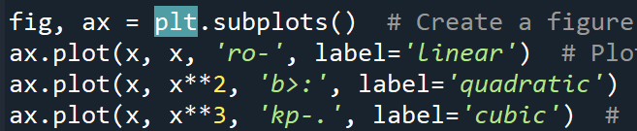
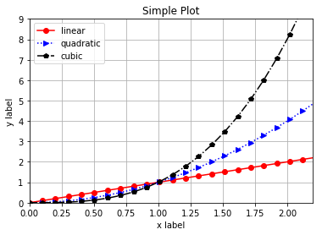
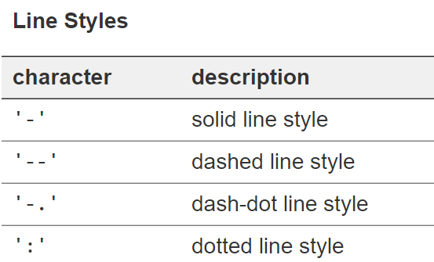
Axes.plot
Plot y versus x as lines and/or markers.
https://matplotlib.org/api/_as_gen/matplotlib.axes.Axes.plot.html#matplotlib.axes.Axes.plot

Slide 9
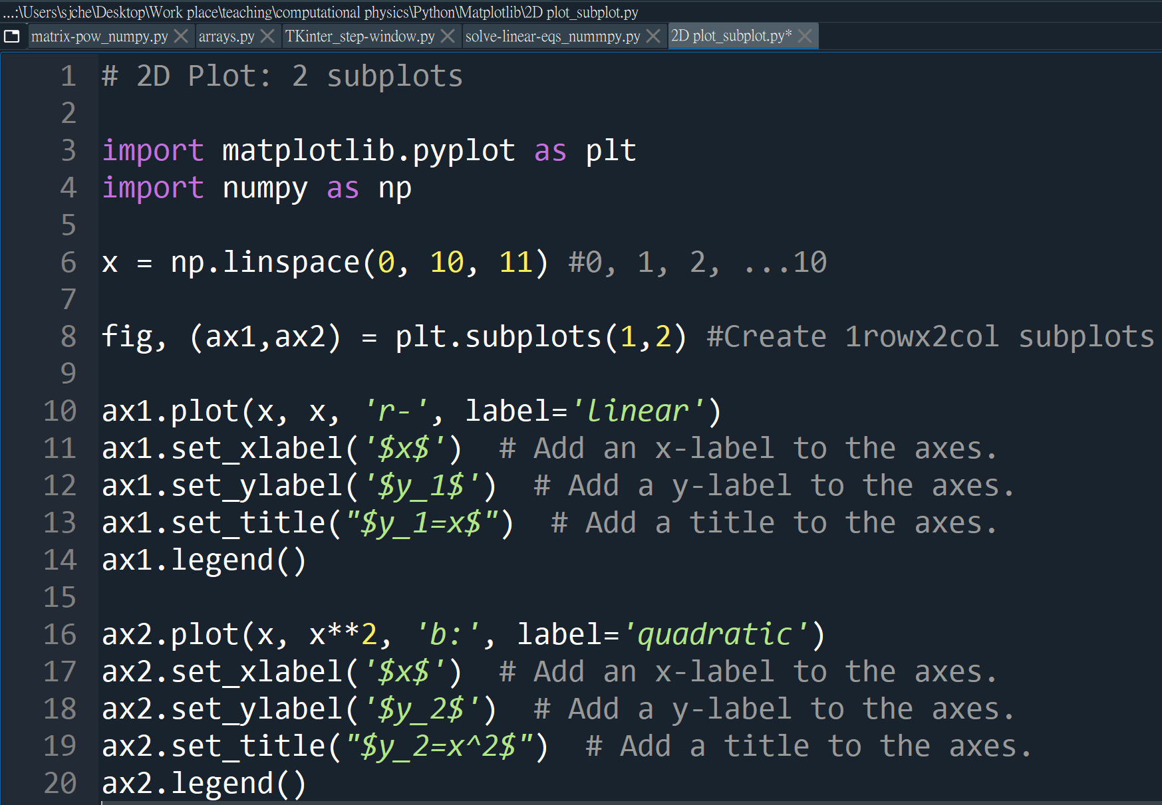
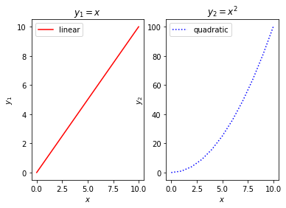
plt.subplots
matplotlib.pyplot.subplots(nrows=1, ncols=1,…)

Slide 10
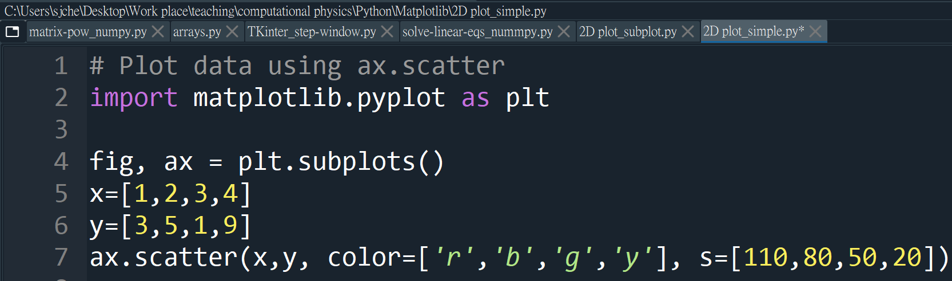
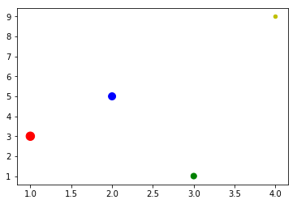
Scatter plot: ax.scatter()

Slide 11
Gallery
https://matplotlib.org/3.1.3/gallery/index.html

Slide 12
Matplotlib: 3D plots
https://medium.com/@yzhong.cs/beyond-data-scientist-3d-plots-in-python-with-examples-2a8bd7aa654b

